Slide 1
Queue

Slide 2
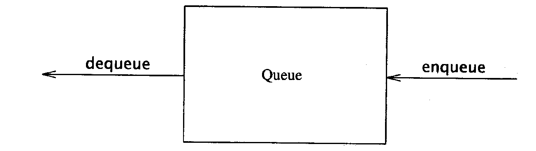
Queue
Like a stack, a queue is also a list. However, with a queue, insertion is done at one end, while deletion is performed at the other end.
Accessing the elements of queues follows a First In, First Out (FIFO) order.
Like customers standing in a check-out line in a store, the first customer in is the first customer served.
Basic operations:
enqueue: insert an element at the rear of the list
dequeue: delete the element at the front of the list

Slide 3
The Queue Operations
A queue is like a line of people waiting for a bank teller. The queue has a front and a rear ends.
New people must enter the queue at the rear. To insert an element in queue is called enqueue operation.
People must leave from the queue at the front. To insert an element in queue is called dequeue operation.
$ $
Front
Rear
Notes:
Don’t ask me why the C++ STL used the name push. It only confuses matters with a stack. In any case, when a new item enters a queue, it does so at the rear.

Slide 4
Enqueue and Dequeue
Primary queue operations: Enqueue and Dequeue
Like check-out lines in a store, a queue has a front and a rear.
Enqueue
Insert an element at the rear of the queue
Dequeue
Remove an element from the front of the queue
Implementation of Queue: Just as stacks can be implemented as arrays or linked lists, so with queues.
Remove (Dequeue)
Insert (Enqueue)
front
rear

Slide 5
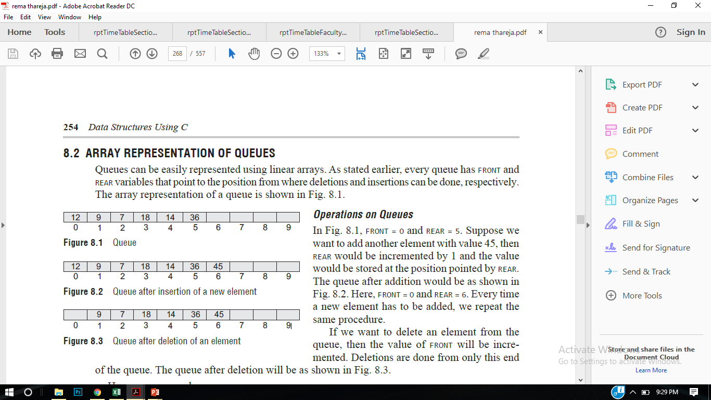
Queue Implementation
Queues can be implemented in two ways:-
Arrays
Linked List
Way I: Queues can be easily represented using linear arrays.
In an array of size 6 , FRONT = 0 and REAR = 5.
Suppose we want to add another element with value 45, then REAR would be incremented by 1 and the value would be stored at the position pointed by REAR.
FRONT = 0 and REAR = 6
If we want to delete an element from the queue, then the value of FRONT will be incremented.
3
6

Slide 6
Insertion (Enqueue) in a Circular Queue
Check if the queue is full: If (rear + 1) % size == front, the queue is full.
If the queue is empty (front = -1), set front = 0.
Move rear to the next position: rear = (rear + 1) % size.
Insert the new element at rear.

Slide 7
Deletion (Dequeue) in a Circular Queue
Check if the queue is empty: If front == -1, the queue is empty.
Retrieve the element at front and remove it.
If there was only one element left, reset front = -1 and rear = -1 (queue becomes empty).
Otherwise, move front to the next position: front = (front + 1) % size.

Slide 8
Queue Operations #include<iostream> #define MAX 10 using namespace std; int queue[MAX]; int front = -1, rear =-1; void insert_element(int value); int delete_element(); int peek(); void display(); int main() { int option, val; char choice='Y'; while(choice=='Y') { cout<<endl<<" ***** MAIN MENU *****"; cout<<endl<<" 1. Insert an element"; cout<<endl<< "2. Delete an element"; cout<<endl<< "3. Peek"; cout<<endl<<" 4. Display the queue"; cout<<endl<<" Enter your option : "; cin>>option; | switch(option) { case 1: cout<<"enter the value to insert"; cin>>val; insert_element(val); break; case 2: val = delete_element(); if (val != -1) cout<<"\n The number deleted is :"<< val<<endl; break; case 3: val = peek(); if (val != -1) cout<<"\n The first value in queue is : "<< val<<endl; break; case 4: display(); break; } cout<<"Enter choice"; cin>>choice; } return 0; }

Slide 9
Queue Operations void insert_element(int value) // Enqueue { if(rear == MAX-1) cout<<"\n OVERFLOW"; else if(front == -1 && rear == -1) front = rear = 0; else rear++; queue[rear] = value; } | int delete_element() // Dequeue { int val; if(front == -1) { cout<<"\n UNDERFLOW"; return -1; } else { val = queue[front]; front++; return val; }}

Slide 10
int peek() // To find the first element { if(front==-1 ) { cout<<"\n QUEUE IS EMPTY"; return -1; } else { return queue[front]; } } void display() // To show the data of queue { int i; cout<<"\n"; if(front == -1 ) cout<<"\n QUEUE IS EMPTY"; else { for(i = front; i <= rear; i++) cout<<"\t "<< queue[i]; } }
Applications of queue
CPU Scheduling (Operating Systems) Processes waiting for CPU time are stored in a queue. The process that arrives first gets executed first.
Printer Queue (Spooling) Multiple print jobs are lined up in a queue. The first document sent to the printer is printed first.
Breadth-First Search (BFS) in Graphs In graph traversal algorithms like BFS, a queue is used to explore nodes level by level.

Slide 11
Queue Implementation with Linked List
Way II: Queues can be easily represented using single linked list.
3
6

Slide 12
Queue Operations #include<iostream> #include<stdlib.h> using namespace std; struct queue { int data; struct queue *next; }; struct queue *temp,*front,*rear; void enqueue(int value); void dequeue(); void display(); int main() { int option, val; char choice='Y'; while(choice=='Y') { cout<<endl<<" ***** MAIN MENU *****"; cout<<endl<<" 1. Insert an element"; cout<<endl<< "2. Delete an element"; cout<<endl<<" Enter your option : "; cin>>option; | switch(option) { case 1: cout<<"enter the value to insert"; cin>>val; enqueue(val); break; case 2: dequeue(); break; case 3: display(); break; } cout<<"Enter choice"; cin>>choice; } return 0; }

Slide 13
void enqueue(int value) { temp=new queue(); temp->data =value; if(front ==NULL && rear ==NULL) // empty queue { front = rear = temp; } else { rear->next =temp; } }

Slide 14
void enqueue(int value) { temp=new queue(); temp->data =value; if(front ==NULL && rear ==NULL) // empty queue { front = rear = temp; } else { rear->next =temp; } } void dequeue() { temp = front; if(front == NULL) { cout<<“underflow”; break; } else { front= temp->next; free(temp);}} | void display() // To show the data of queue { temp =front; cout<<"\n"; if(front == NULL ) cout<<"\n QUEUE IS EMPTY"; else { while(temp!=NULL) { cout<<temp->data; temp=temp->next; } }

Slide 15
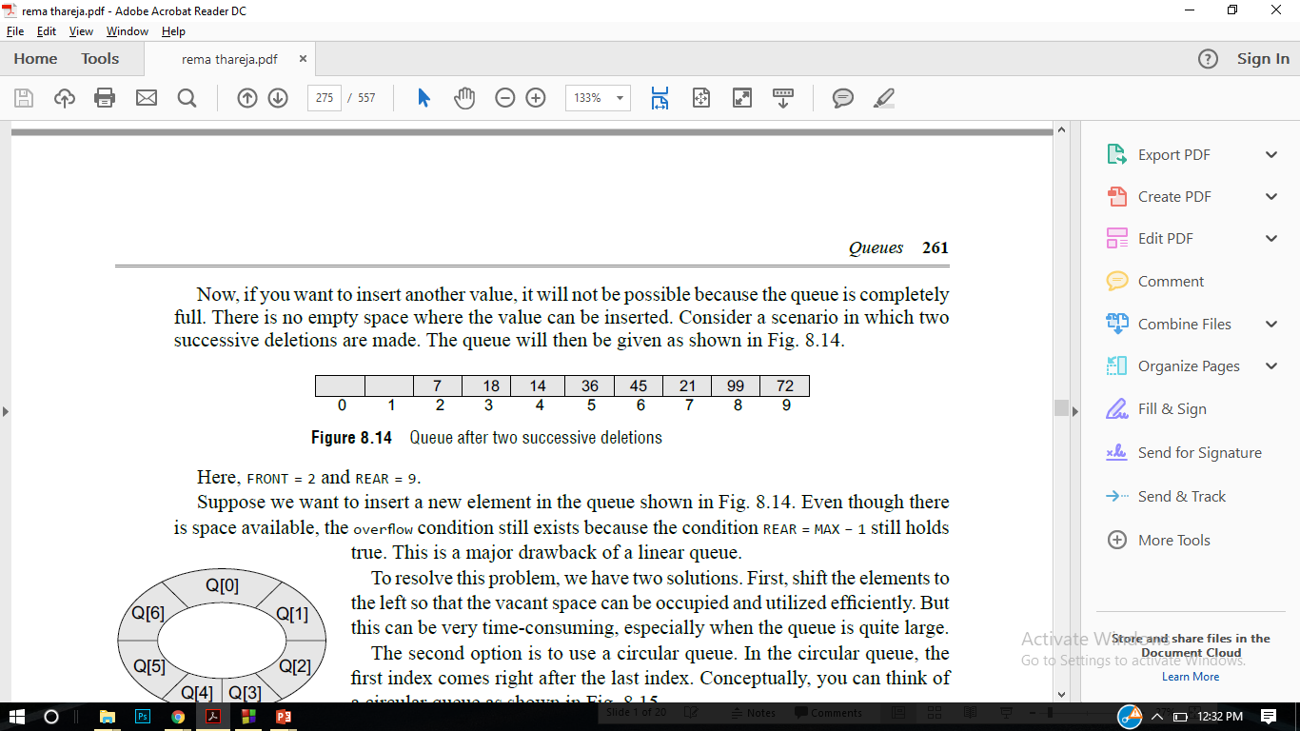
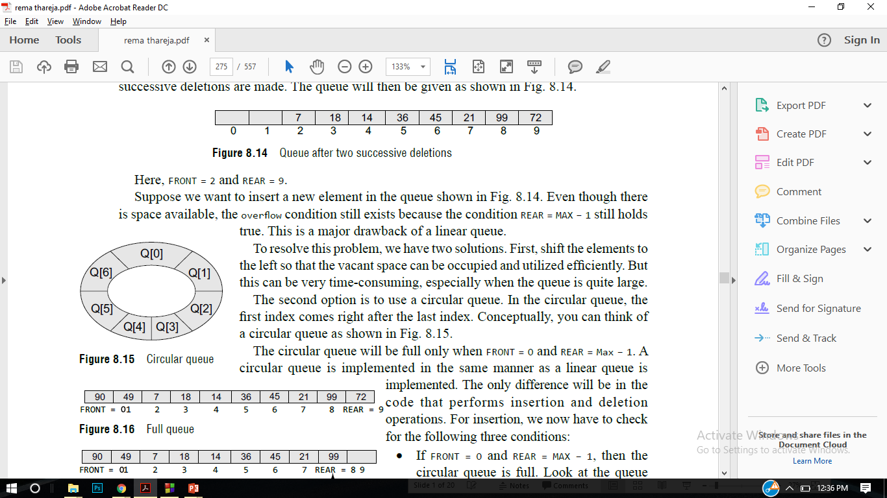
Circular Queue
If you want to insert another value, it will not be possible because the queue is completely full. There is no empty space where the value can be inserted. Consider a scenario in which two successive deletions are made.
front = 2 and REAR = 9.
Even though there is space available, the overflow condition still exists because the condition rear = MAX – 1 still holds true. This is a major drawback of a linear queue.
The second option is to use a circular queue. In the circular queue, the first index comes right after the last index.

Slide 16
Priority Queue (Definition)
A Priority Queue is a special type of queue in which each element has a priority. The element with the highest priority is removed first, not the one that was inserted first.
In array implementation, elements are stored in an array like:
[4, 1, 3, 2]

Slide 17
During deletion, the highest priority element is found and removed first.
Example removal order:
4 → 3 → 2 → 1

Slide 18
CPU Scheduling
In an operating system, processes are executed based on priority.
[Process1(2), Process2(5), Process3(1)]
Execution order:
Process2 → Process1 → Process3

Slide 19
Printer Queue
Network Packet Routing
Hospital Emergency System

Slide 20
insert(30,3)
Queue: (30,3)
insert(10,1)
Queue: (10,1) (30,3)
insert(20,2)
Queue: (10,1) (20,2) (30,3)
insert(40,4)
Queue: (10,1) (20,2) (30,3) (40,4)

Slide 21
front = 0 rear = 3
Index: 0 1 2 3
(10,1) (20,2) (30,3) (40,4)
front → always 0 (unless deletion happens)rear → increases by 1 after every insertion
Why do we not change front during insertion?
Answer: Because elements are shifted inside the array, so the first element always remains at index 0.

